Slide 1



DATA ANALYSIS ON
TELECOMMUNICATION
TEAM 9
SAADHIKA
PAVAN
AKANKSHA
SHIVANI

Slide 2



WHAT IS TELECOMMUNICATION?
THE EXCHANGE OF INFORMATION OVER A LARGE DISTANCES
TELECOMMUNICATION STRATAGIES
TO SURVIVE IN THIS COMPETITIVE MARKET TELECOM SECTOR USES MULTIPLE STRATEGIES:
THE THREE MAIN STRATEGIES ARE:
1. ACQUIRE NEW CUSTOMERS
2. UPSELL THE EXISTING CUSTOMERS
3. INCREASE THE RENTENTION PERIOD OF CUSTOMERS

Slide 3

LET’S UNDERSTAND MORE ABOUT DATA
DEMOGRAPHIC INFO :
'CUSTOMERID', 'GENDER', 'SENIORCITIZEN', 'PARTNER', 'DEPENDENTS'.
CUSTOMER ACCOUNT INFO :
'Contract', 'PaperlessBilling','PaymentMethod', 'MonthlyCharges', 'TotalCharges',’churn’,’tenure’.
SERVICES CUSTOMERS SIGNED UP :
'PHONESERVICE', 'MULTIPLELINES', 'INTERNETSERVICE',
'ONLINESECURITY', 'ONLINEBACKUP', 'DEVICEPROTECTION', 'TECHSUPPORT',
'STREAMINGTV', 'STREAMINGMOVIES',

Slide 4


HOW TO INCREASE RETENTION
PERIOD OF CUSTOMERS?
REDUCING THE ‘’CHURN’’

Slide 5

WHAT IS CHURN?
CUSTOMER WHO CLOSES THEIR CONTRACT OR CUSTOMER MOVEMENT FROM ONE PROVIDER TO ANOTHER

Slide 6


HOW TO REDUCE CHURN?
BY CONSIDERING TARGET VARIABLE
AS ‘’CHURN’’, ANALYSE THE DATA AND GENERATE INSIGHTS WHICH GIVES DATA DRIVEN DECISIONS
SOME ANALYSIS ARE .......

Slide 7
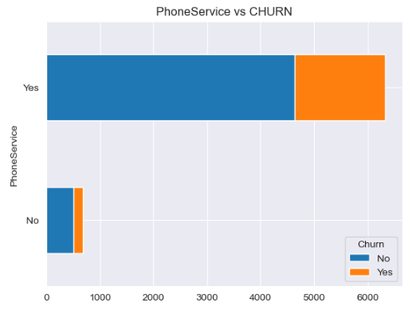
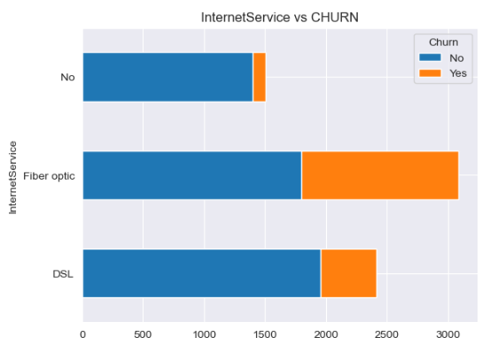
PHONESERVICE VS CHURN
INTERNETSERVICE VS CHURN
THE CUSTOMER CHURN RATE IS HIGHER FOR THOSE WHO HAVE FIBER OPTICS AS INTERNET SERVICE
THE CUSTOMER CHURN RATE IS HIGHER FOR THOSE WHO HAVE PHONE SERVICE

Slide 8
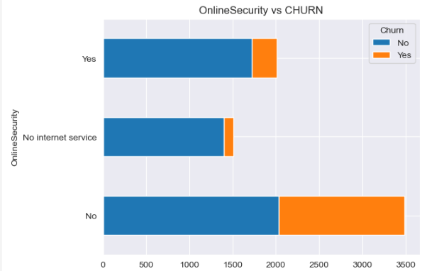
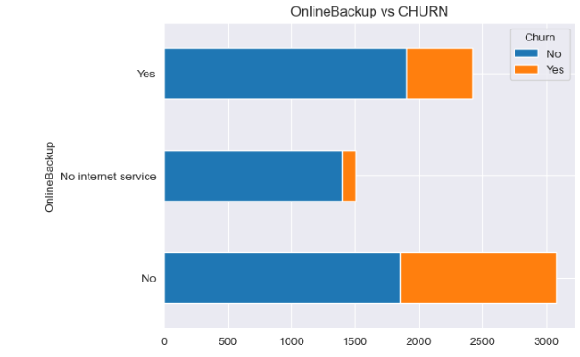
ONLINE SECURITY VS CHURN
ONLINE BACKUP VS CHURN
THE CUSTOMER CHURN RATE IS HIGHER FOR THOSE WHO HAVE NO ONLINE SECURITY
THE CUSTOMER CHURN RATE IS HIGHER FOR THOSE WHO HAVE NO ONLINE BACKUP

Slide 9
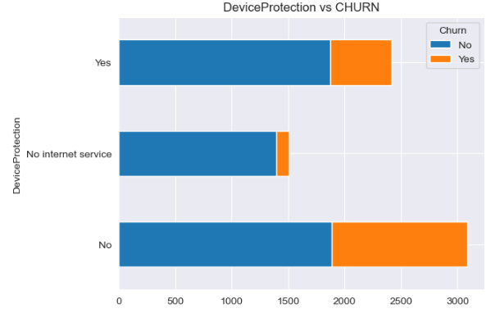
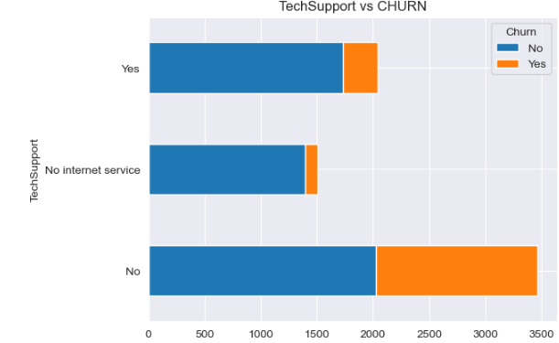
DEVICE PROTECTION VS CHURN
TECHSUPPORT VS CHURN
THE CUSTOMERS CHURN RATE IS HIGHER FOR THOSE WHO HAVE NO DEVICE PROTECTION
THE CUSTOMER CHURN RATE IS HIGHER FOR THOSE WHO HAVE NO TECH SUPPORT

Slide 10

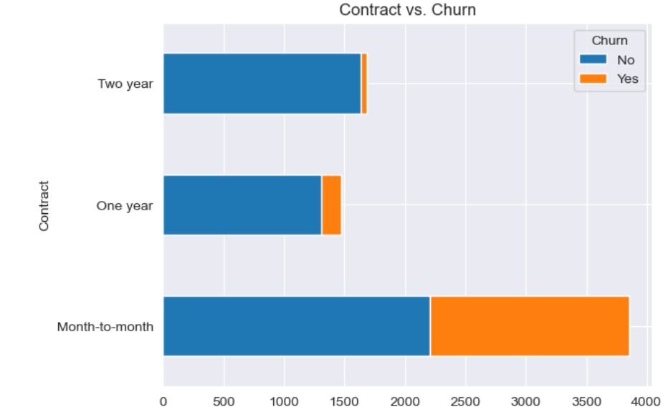
CONTRACT VS CHURN
THE SHORTER THE
CONTRACT,
THE HIGHER THE
CHURN OF CUSTOMERS

Slide 11

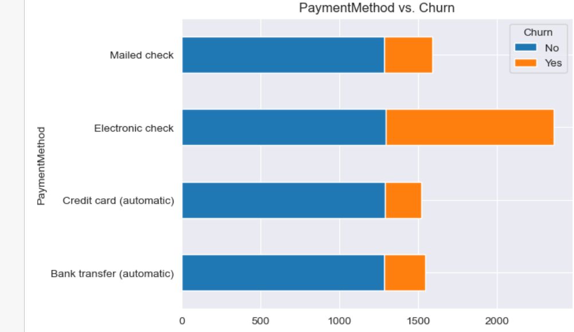
PAYMENTMETHOD VS CHURN
THE CUSTOMER CHURN RATE IS HGHER
FOR THOSE WHO HAVE
PAYMENT METHOD AS
ELECTRONIC CHECKS

Slide 12
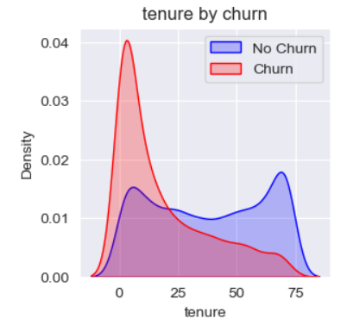
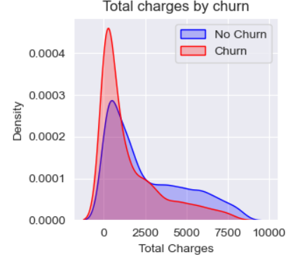
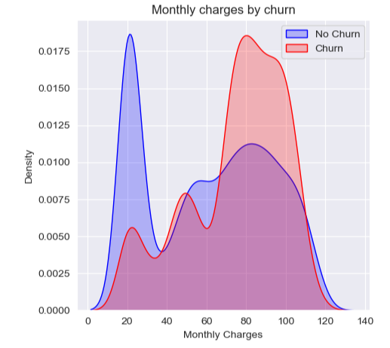

TENURE, TOTALCHARGES, MONTHLYCHARGES VS CHURN
LOWER TENURE, LOWER TOTAL CHARGE, AND HIGHER MONTHLY CHARGE ARE ASSOCIATED WITH HIGH CHURN.

Slide 13

INSIGHTS :
THE HIGH CHURN IS FOR
THE CUSTOMER WHO OPTED FOR “PHONE SERVICE” AND INTERNET SERVICE AS “FIBER OPTICS”.
THE CUSTOMER WHO HAVE “NO ONLINE SECURITY”, “NO ONLINE BACKUP”, ”NO DEVICE PROTECTION” AND “NO TECH SUPPORT”.
THE CUSTOMERS WHO HAVE LESS “CONTRACT PERIOD” AND PAYMENT METHOD AS “ELECTRONIC CHECK”.
CUSTOMERS WITH LOWER TENURE,LOWER TOTAL CHARGES, AND HIGHER MONTHLY CHARGES

Slide 14

RECOMMENDATIONS :
COMBINING PHONE AND FIBER OPTIC INTERNET SERVICES, CAN OFTEN RESULT IN COST SAVINGS COMPARED TO HAVING SEPARATE PLANS.
OFFERING PACKAGES OR ADD-ONS THAT IMPROVE ONLINE SECURITY, PROVIDE DEVICE PROTECTION, AND INCLUDE TECHNICAL SUPPORT CAN ENHANCE THE OVERALL SERVICING OFFERING.
CONSIDER OFFERING FLEXIBLE CONTRACT PLANS, EXCEPTIONAL CUSTOMER SUPPORT, COMPETITIVE PRICING AND PROMOTIONS .
PROVIDE REAL-TIME PAYMENT CONFIRMATION,FASTER CHECK CLEARING AND E-CHECK VERIFICATION SERVICES FOR ELECTRONIC CHECK PAYMENTS.

Slide 15

THANK YOU

